Slide 1

University of Nairobi
Department of Political Science and Public Administration
Webinar
Post-Covid Academic Research, Training and Teaching
Creating the Future for the University:
Building on our Covid-19 Skills and Avoiding our Mistakes
Sir John Daniel
Chancellor
Acsenda School of Management
Vancouver

Slide 2
University of Nairobi
Department of Political Science and Public Administration
Webinar
Post-Covid Academic Research, Training and Teaching
Creating the Future for the University:
Building on our Covid-19 Skills and Avoiding our Mistakes
From
Emergency Remote Teaching
to
Open Distance Learning

Slide 3
Plan
Explore 6 aspects of distance learning
A long history
Material for teaching; interaction for learning
Get the material to the students
Economy of scale and quality of scale
Reaching ordinary people
Teamwork

Slide 4
A LONG HISTORY
Deeply rooted in Africa:
East, West and South
ODL did not begin with the Internet
St. Paul’s letters to early churches
Integration of newer technologies

Slide 5
MATERIAL FOR TEACHING
INTERACTION FOR LEARNING
Independence & Interaction:
Getting the mixture right
Live video lectures not enough
Asynchronous activities for students

Slide 6
GET THE MATERIAL TO THE STUDENTS
Students perform better when they can review materials on their own
This is easier and cheaper as technology improves our capacity to print, copy & distribute

Slide 7


Slide 8
ECONOMY OF SCALE – QUALITY OF SCALE
Economy of scale
Quality of scale
OPEN EDUCATIONAL RESOURCES (OER)

Slide 9
REACHING ORDINARY PEOPLE
Example of OPEN UNIVERSITIES

Slide 10

Open as to:
People
Places
Methods
Ideas

Slide 11
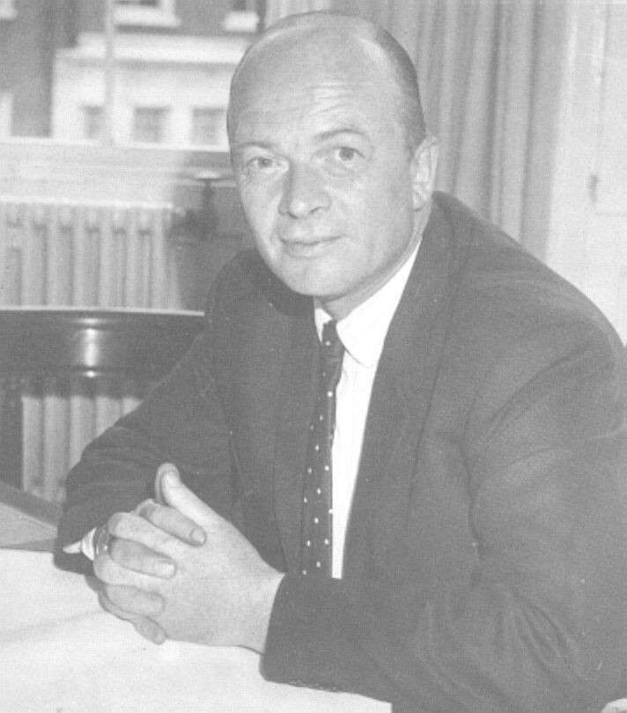
The key UKOU
innovation
was the
COURSE TEAM
It was how the UKOU
institutionalized innovation
Lord Walter Perry
Founding Vice-Chancellor
The Open University

Slide 12
TEAMWORK
Making university teaching a
PUBLIC
activity

Slide 13
Impact of COVID-19
Good:
Millions more teachers and students have experience of distance learning
Bad:
Remote teaching has taken the OPEN out of OPEN and distance learning

Slide 14
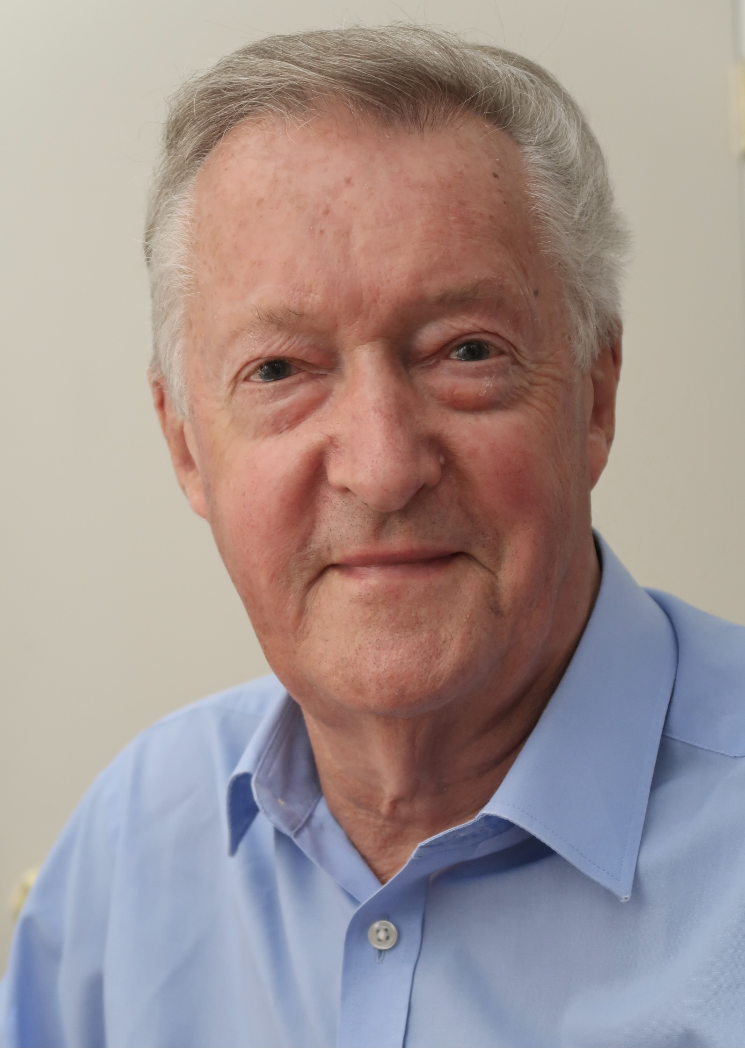
Thank you
Sir John Daniel
Text & Slides
www.sirjohn.ca

